Slide 1
THE SILENT CRISIS:
MENTAL HEALTH BURDEN AND IMPACT ON HEALTHCARE WORKERS IN KENYA
Presenter: Stella Gacheri Muriuki
Clinical Officer – Mental Health and Psychiatry
Student, School of Social Sciences, Mount Kenya University
Date: 16/10/2025
“Mental health is not a luxury for healthcare workers – it is a necessity for quality care.”

Slide 2
Introduction
Mental health disorders are an escalating but under-discussed challenge in Kenya (WHO, 2022). Healthcare professionals face high stress from limited resources, heavy patient loads, and ethical challenges.
Impact: Burnout, depression, and diminished patient safety. Addressing mental health enhances resilience and system performance (MOH Kenya, 2023).

Slide 3
The Growing Burden in Kenya
Kenya’s mental health burden is significant:
- Depression, anxiety, and substance use disorders are widespread.
- Stigma and urban–rural inequality persist.
- Approximately 25% of Kenyans experience mental health conditions (WHO, 2022).
- Only 30% of facilities offer basic mental health services (MOH, 2023).

Slide 4
The Healthcare Worker Crisis
Among healthcare workers:
- Burnout: 30–50%; Depression: 25–40%; Anxiety/PTSD are common (Othieno et al., 2021).
Drivers include low wages, staffing gaps, limited PPE, stigma, poor work–life balance, and exposure to trauma.
Quote: “Caring for those who care for others must be a public health priority.”

Slide 5
Impact on Healthcare and Society
Consequences include:
- Individual: Emotional exhaustion, substance use, attrition.
- Systemic: Increased medical errors, absenteeism, compromised care quality.
- Economic: Staff turnover and retraining costs (KNH–MOH Report, 2024).
Mental distress in healthcare workers can indirectly increase national health expenditure by up to 10% (WHO, 2023).

Slide 6
Barriers to Support
Key barriers:
- Cultural stigma around mental health discussions.
- Limited confidential counseling services.
- Few workplace wellness policies.
- Poor mental health data and monitoring (Kenya Health Policy Review, 2023).

Slide 7
Methods
Approach: Narrative synthesis using MOH and WHO Kenya reports, cross-sectional surveys, peer-reviewed studies, and program evaluations.
Goal: Characterize prevalence, identify drivers, and analyze consequences within Kenyan healthcare settings.

Slide 8
Interventions That Work
Evidence-based actions:
- Integrate mental health screening into primary care (WHO mhGAP, 2022).
- Implement peer-support and debriefing programs.
- Establish national anti-stigma campaigns.
- Use dashboards to monitor healthcare worker well-being.
- Involve community and faith leaders for psychosocial outreach.

Slide 9
Discussion
A resilient health system depends on the well-being of its workforce.
Without addressing mental health, Kenya risks reduced care quality and workforce shortages.
Collaboration required: Ministry of Health, universities, NGOs, and private sector (MOH, 2023).

Slide 10
Call to Action
1. Implement workplace mental health programs: peer support and burnout mitigation.
2. Integrate mental health into all facility improvement plans.
3. Establish national data dashboards for workforce well-being.
4. Ensure sustainable funding and supportive policies (MOH, 2024).

Slide 11
Kenya’s Path Forward
Safeguard caregivers to ensure healthcare system resilience.
Improve patient outcomes by promoting emotionally healthy healthcare providers.
Adopt scalable, data-driven mental health models with evidence-based monitoring.

Slide 12
Key Note
MENTAL HEALTH IS FOUNDATIONAL TO HEALTHCARE, NOT OPTIONAL.
“If we heal the healers, we heal the nation.”
References:
- WHO (2022, 2023). Mental Health Atlas.
- Ministry of Health Kenya (2023). Kenya Mental Health Policy Review.
- Othieno C.J. et al. (2021). Burnout among healthcare providers in Kenya. BMC Psychiatry.
- KNH & MOH Joint Report (2024). Well-being of Healthcare Workforce in Kenya.

Slide 13
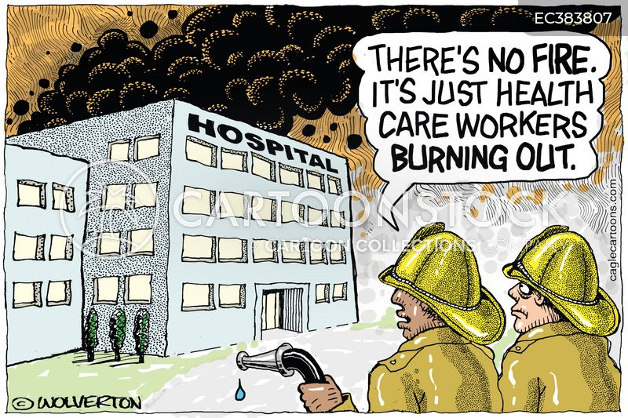

Slide 14


